Slide 1
Geometric Objects
Angel: Interactive Computer Graphics 5E © Addison-Wesley 2009

Slide 2
Objectives
Introduce the elements of geometry
  Vectors
  Points
  Lines
  Planes
Describe methods to generate
  random curves
  random surfaces
Angel: Interactive Computer Graphics 5E © Addison-Wesley 2009

Slide 3
Vectors
Physical definition: a vector is a quantity with two attributes
  Direction
  Magnitude
Examples include
  Force
  Velocity
  Directed line segments
v
Angel: Interactive Computer Graphics 5E © Addison-Wesley 2009

Slide 4
Vector Operations
Every vector has an inverse
  Same magnitude but points in opposite direction
Every vector can be multiplied by a scalar
There is a zero vector
  Zero magnitude, undefined orientation
The sum of any two vectors is a vector
  Use head-to-tail axiom
v
w
v
-v
αv
u
Angel: Interactive Computer Graphics 5E © Addison-Wesley 2009

Slide 5

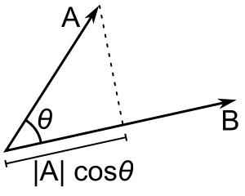
Vector Operations
The dot product of two vectors a = [a1, a2, … , an] and b = [b1, b2, … , bn] is defined as:
The dot product can be used to calculate the angle between two vectors:
Angel: Interactive Computer Graphics 5E © Addison-Wesley 2009

Slide 6

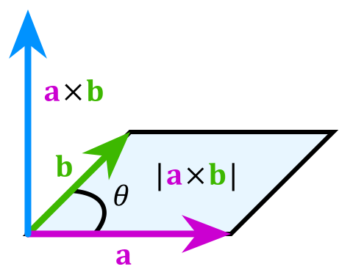
Vector Operations
The cross product of two vectors a = [a1, a2, a3] and b = [b1, b2, b3] is defined as:
a x b = (a2 b3 - a3 b2, a3 b1 - a1 b3, a1 b2 - a2 b1)
The cross product can be used
to find a vector that is
perpendicular to two vectors
Angel: Interactive Computer Graphics 5E © Addison-Wesley 2009

Slide 7
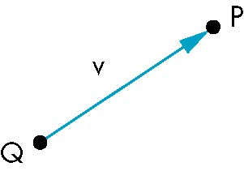
Points
Location in space
Operations allowed between points and vectors
  Point-point subtraction yields a vector
  Equivalent to point-vector addition
v = P-Q
P = v+Q
Angel: Interactive Computer Graphics 5E © Addison-Wesley 2009

Slide 8
Lines
Two-dimensional line equations
  Explicit:
  y = mx +b
  Implicit:
  ax + by +c = 0
  (a,b) . (x,y) = -c
  Parametric:
  x(α) = αx₀ + (1-α)x₁
  y(α) = αy₀ + (1-α)y₁
Angel: Interactive Computer Graphics 5E © Addison-Wesley 2009

Slide 9
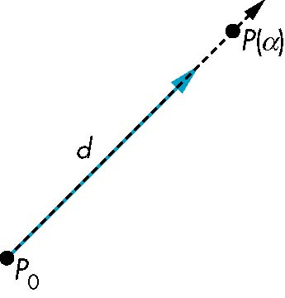
Lines
The parametric form of the line equation:
  P(α) = P₀ + α d
Set of all points that pass through P₀ in the direction of the vector d
Angel: Interactive Computer Graphics 5E © Addison-Wesley 2009

Slide 10
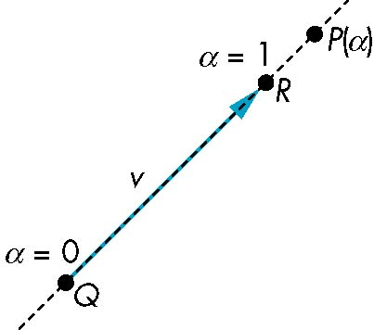
Lines
If we use two points P and Q to define v, then the line equation becomes:
P(α) =αR + (1-α)Q
For 0<=α<=1 we get all the points on the line segment joining R and Q
Angel: Interactive Computer Graphics 5E © Addison-Wesley 2009

Slide 11
Planes
Three-dimensional plane equations
  Explicit:
  z = mx +ny + p
  Implicit:
  ax + by + cz + d = 0
  (a,b,c) . (x,y,z) = -d
  Parametric:
  x(α,β) = x₀ + α(x₁-x₀) + β(x₂-x₀)
  y(α,β) = y₀ + α(y₁-y₀) + β(y₂-y₀)
  z(α,β) = z₀ + α(z₁-z₀) + β(z₂-z₀)
Angel: Interactive Computer Graphics 5E © Addison-Wesley 2009

Slide 12
Planes
A plane can be defined in terms of three points (P,Q,R) or in terms of one point and two vectors.
The parametric plane equation is:
T(α,β) = P + α(Q-P) + β(R-P)
Q
β
a
T(α,β)
P
α
R
Angel: Interactive Computer Graphics 5E © Addison-Wesley 2009

Slide 13
Generating Random Curves
Many natural objects can be modeled by sequences of random line segments (eg. lightning bolts, the path an insect flies)
One approach is the recursive line bisection displacement algorithm
  Start with line A B
  Calculate midpoint C = (A+B)/2
  Add random (x,y,z) displacement to midpoint
  Recursively bisect lines A C and C B
  Draw lines when their length < threshold

Slide 14
Generating Random Curves
C1
B
A
C3
C1
B
C2
A

Slide 15
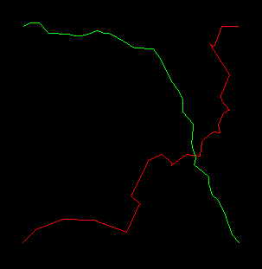
Generating Random Curves
Smoothness or roughness of random curves can be controlled by:
  The size of the random (x,y,z) displacement
  The number of recursive subdivisions used

Slide 16
Generating Random Surfaces
Many natural objects can be modeled by random surfaces (eg. mountain terrain, surface of water)
One approach is to extend the recursive line bisection algorithm to three dimensions
  Start with a triangle defined by ABC
  Calculate midpoint of each side
    D = (A+B)/2, E = (B+C)/2, F= (C+A)/2
  Add random (x,y,z) displacements to midpoints
  Recursively bisect four new triangles
    ADF, BED, CFE, and DEF
  Draw triangles when their area < threshold

Slide 17
Generating Random Surfaces
B
B
D
D
E
E
A
A
F
F
C
C
Split ABC
Split BED

Slide 18
Generating Random Surfaces
B
Notice the gap in surface between points D and E?
D
D
E
E
This problem can be avoided by re-using the random displacement between D and E for both triangles.
A
F
C
Split DEF

Slide 19
Generating Random Surfaces
B
B
D
D
E
E
A
A
F
F
C
C
Split DEF
Split ADF and CFE

Slide 20
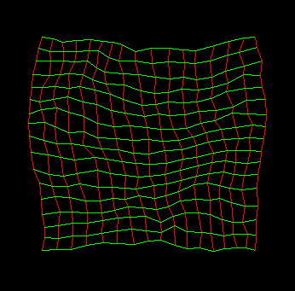
Generating Random Surfaces
The (x,y,z) coordinates of the random surface can be stored in a 2D array and displayed as a mesh

